Slide 1
OSU Mercury Robotics
the ENGINEERING Design Cycle

Slide 2
The Engineering Design Cycle
Sequence of events from idea generation to finished product
Flow chart representation . . .

Slide 3
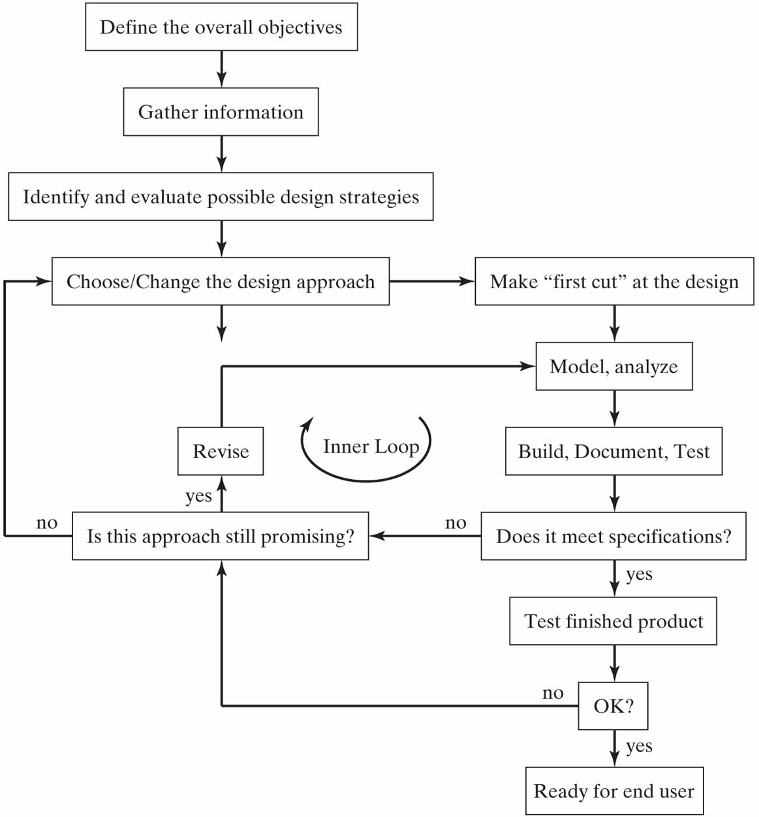
Source: Horenstein, Design Concepts for Engineers

Slide 4
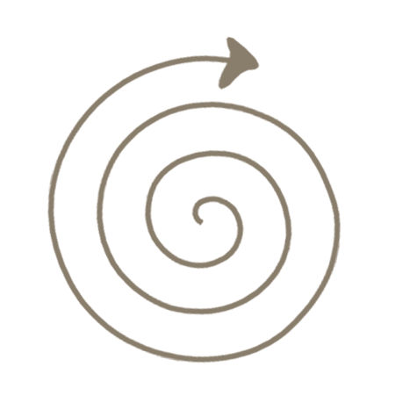
A simpler representation
Problem Analysis
Design Generation
Design Evaluation
Design Realization

Slide 5
Problem Analysis
Goal: Clear and complete statement of problem to be solved.
Critical first step
What is the problem we are trying to solve?
What are our objectives in the design?
What are the constraints?
Have to have vs. nice to have
Do research – How have similar problems (or parts of the problem) been solved? What off-the-shelf components can help us?
Note: Invest the time here!!
Don’t solve the “wrong” problem!!

Slide 6
Problem Analysis, cont.
Process:
Clearly state the problem as given to us.
Identify all given requirements
Safety requirements, communications requirements, etc.
Identify additional requirements that emerge from the contest objectives, track, etc. (“Derived” rqmts.)
Prioritize from most to least important
Translate to Technical Requirements

Slide 7
Design Generation
Goal: Come up with multiple candidate solutions for the problem and select “best” to carry forward.
Techniques include:
Brainstorming (individual & group)
Some “guidelines”
No holding back – any idea, any time
No boundaries – no idea is “too crazy”
No criticizing – don’t critique until the final discussion
No dismissing – don’t discount an idea
No limit – one more idea is always good
No restrictions – draw from any field of experience
No shame – no one should ever be made to feel embarrassed about an idea

Slide 8
Design Generation
Goal: Come up with multiple candidate solutions for the problem and select “best” to carry forward.
Techniques include (cont.):
Benchmarking
How have other people solved the problem? (Don’t reinvent the wheel!)
Back of Envelope analysis
Quick check using very simplified model to estimate performance
Tradeoff Analysis
Which idea will work “best”?
Weighted decision matrices can be helpful!

Slide 9
Design Generation Weighted Decision Matrices
To make confident and rational decisions when you have multiple options and multiple factors to take into account.
Step 1: List each option as a column heading and each factor/criteria as a row.
Step 2: Assign a “weight” to each criteria based on its relative importance.
Step 3: Work through the table, giving a raw score to each option for each criteria.
Step 4: Multiply raw scores by weights.
Step 5: Add up the weighted scores for each option and look for the highest.

Slide 10
Decision Matrix Example
Scale for Weight Values:
4 Critical importance
3 High importance
2 Medium importance
1 Low importance
0 Minimum importance

Slide 11
Decision Matrix Example
2
1
4
2
1
3
1
4
2
2
1
3
3
4
1
0
3
4
2
4
2
3
2
3
2
Scale for Weight Values:
4 Critical importance
3 High importance
2 Medium importance
1 Low importance
0 Minimum importance
Scale for Raw Scores:
4 Far exceeds requirement
3 Exceeds requirement
2 Meets requirement
1 Minor deficiencies
0 Does not meet requirement

Slide 12
Decision Matrix Example
2
1
4
2
1
2
1.5
4
4
3
14.5
3
1
4
2
2
3
1.5
4
4
6
18.5
1
3
3
4
1
1
4.5
3
8
3
19.5
0
3
4
2
4
0
4.5
4
4
12
24.5
2
3
2
3
2
2
4.5
2
6
6
20.5
Scale for Weight Values:
4 Critical importance
3 High importance
2 Medium importance
1 Low importance
0 Minimum importance
Scale for Raw Scores:
4 Far exceeds requirement
3 Exceeds requirement
2 Meets requirement
1 Minor deficiencies
0 Does not meet requirement

Slide 13
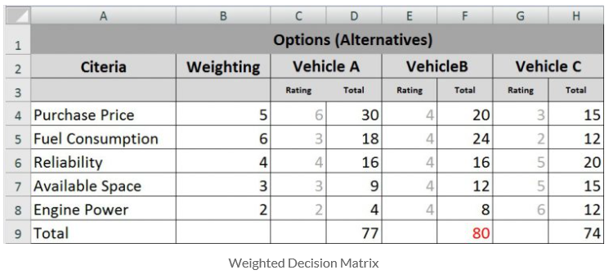
Another Example
source: https://www.infonautics.ch/blog/decision-matrix/

Slide 14
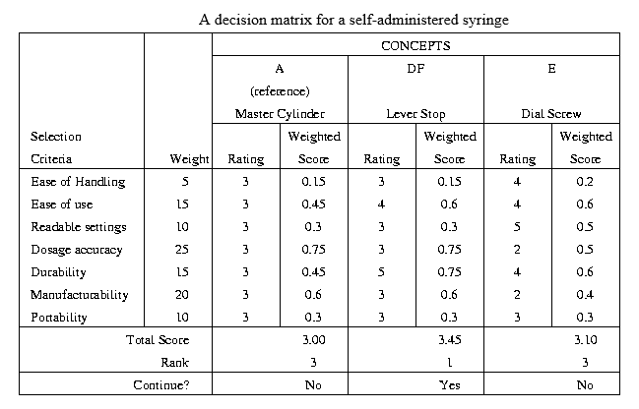
Another Example
source: http://deseng.ryerson.ca/~fil/t/oldT/concept/evaluation1.html

Slide 15
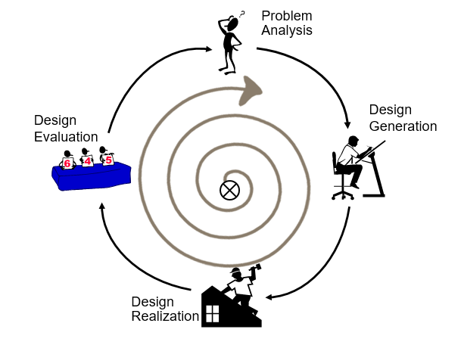
Design Realization
Modeling / analysis / simulation
Create a working prototype (if practical)
Needs to function, doesn’t have to be pretty.
Use materials that are easy to work with.
Later prototypes may come very close to final design.
Document throughout the process
What worked, what didn’t work, design modifications, etc.

Slide 16
Design Evaluation
Test thoroughly!
Does it work?
Meets all technical specifications?
Assess performance in different conditions and scenarios.
Repeat the design cycle if problems are discovered.

Slide 17
The Design Cycle
Problem Analysis
Design Evaluation
Design is an iterative process!
Final product may be completely different than what was initially envisioned.
Design Generation
Design Realization
Prepare for failure –
Don’t be discouraged! Failure is a normal part of the design process, and it is how we learn the most!

Slide 18
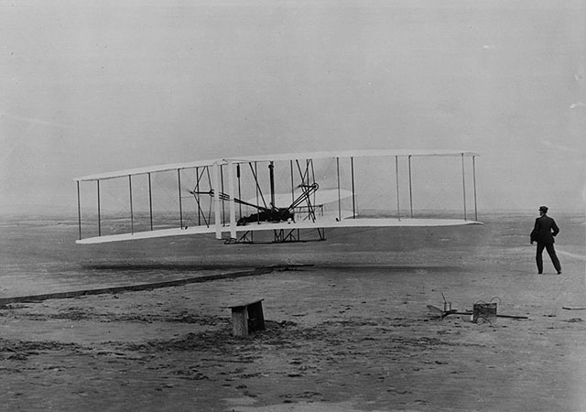
If you are looking for perfect safety you will do well to sit on a fence and watch the birds; but if you really wish to learn you must mount a machine and become acquainted with its tricks by actual trial. Wilbur Wright

Slide 19
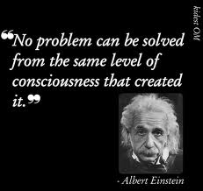
If you are looking for perfect safety you will do well to sit on a fence and watch the birds; but if you really wish to learn you must mount a machine and become acquainted with its tricks by actual trial. Wilbur Wright

